Slide 1
Internship presentation

Slide 2

name : shashwat dwivedi BRANCH : CSE-3 STUDENT NO : 2010094 ROLL NO : 2000270100144
By :

Slide 3

ABOUT MY INTERNSHIP
I’ve completed my internship from REMARK SKILLS in WEB DEVELOPMENT domain.
This course was in-depth introduction to fundamentals of HTML , CSS and JAVASCRIPT.

Slide 4
TOPIC :
DEVELOPMENT OF CHROME EXTENSION USING JAVASCRIPT

Slide 5
ABOUT CHROME EXT.
It is a small program to modify the experience or add functionality to the chrome browser. They are created using web technology like HTML, CSS, JavaScript, etc.

Slide 6
The main aim of an extension is to serve a single purpose around which the whole program is built, although it can have multiple components but they should help in accomplishing the main purpose of the program.
Some example of chrome extension is:
Password manager
Ads blocker
Adding to-do lists or notes to Chrome
Making it easier to copy text from a site

Slide 7
OBJECTIVE
TO PROVIDE A TOOL FOR MAKING NOTES EASILY
& EFFECTIVELY.

Slide 8
Basic Structure of Chrome Ext.
Manifest
HTML
CSS
JavaScript
.crx Zipped file
Chrome Web Store

Slide 9

MANIFEST.JSON
The manifest.json is a simple JSON file in your website that tells the browser about your website on user's mobile device or desktop. Having a manifest is required by Chrome to show the Add to Home Screen prompt.
The manifest.json file contains details of your website app name, icons it should use, the permissions it requires, and many other details.
Using manifest.json , you specify basic metadata about your extension such as the name and version, and can also specify aspects of your extension's functionality (such as background scripts, content scripts, and browser actions).

Slide 10

…
INTRODUCTION TO HTML

Slide 11
What is HTML?
HTML stands for Hyper Text Markup Language
HTML is the standard markup language for creating Web pages
HTML describes the structure of a Web page
HTML consists of a series of elements
HTML elements tell the browser how to display the content

Slide 12

INTRODUCTION TO CSS
CSS stands for Cascading Style Sheets
CSS describes how HTML elements are to be displayed on screen, paper, or in other media
CSS saves a lot of work. It can control the layout of multiple web pages all at once
External stylesheets are stored in CSS files

Slide 13

What Is JavaScript??
JavaScript is a scripting language used to create and control dynamic website content, i.e. anything that moves, refreshes, or otherwise changes on your screen without requiring you to manually reload a web page. Features like:
animated graphics
photo slideshows
autocomplete text suggestions
interactive forms

Slide 14
JavaScript is a lightweight, cross-platform, and interpreted scripting language. It is well-known for the development of web pages, many non-browser environments also use it.
Main function of javascript is to add functionality to the web page.

Slide 15
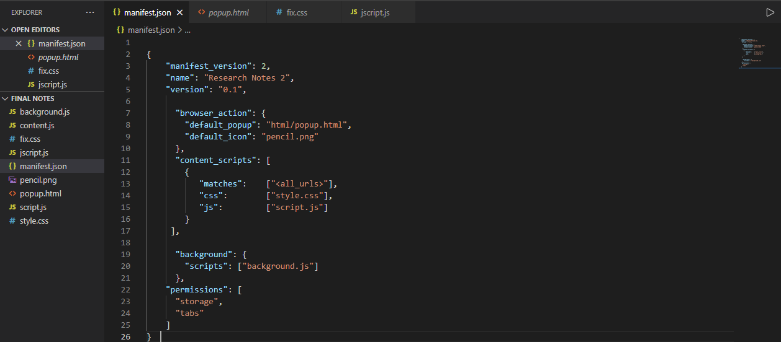
1) Manifest . json

Slide 16
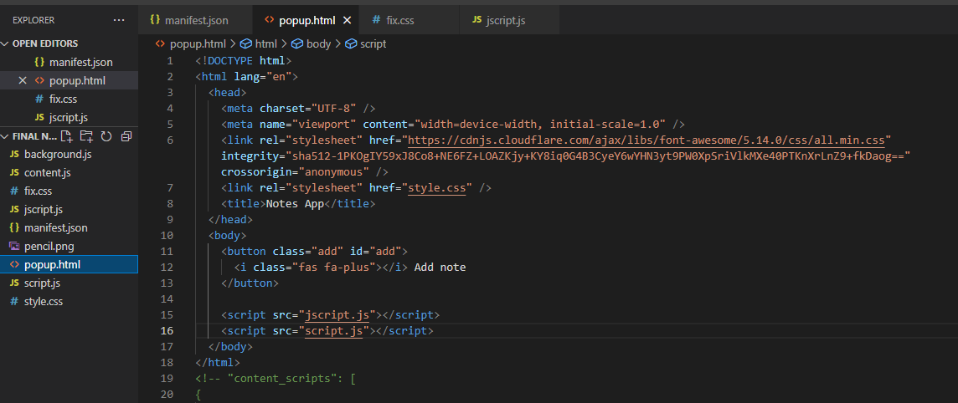
2) popup.html

Slide 17
Overview of different html tags used:
1) <!DOCTYPE> - All HTML documents must start with a <!DOCTYPE> declaration. The declaration is not an HTML tag. It is an "information" to the browser about what document type to expect.
2) <head> - The <head> element is a container for metadata (data about data) and is placed between the <html> tag and the <body> tag. Metadata typically define the document title, character set, styles, scripts, and other meta information.
3) <meta> - <meta> tags always go inside the <head> element, and are typically used to specify character set, page description, keywords, author of the document, and viewport settings.
4) <link> - The <link> tag defines the relationship between the current document and an external resource. The <link> tag is most often used to link to external style sheets to your website.
5) <Title> - The <title> tag defines the title of the document. The title must be text-only, and it is shown in the browser's title bar or in the page's tab.
6) <body> - The <body> element contains all the contents of an HTML document, such as headings, paragraphs, images, hyperlinks, tables, lists, etc.

Slide 18
7) <script> - The <script> tag is used to embed a client-side script (JavaScript).
8) <button> - The <button> tag defines a clickable button. Inside a <button> element you can put text (and tags like <i>, <b>, <strong>, <br>, <img>, etc.). That is not possible with a button created with the <input> element!

Slide 19
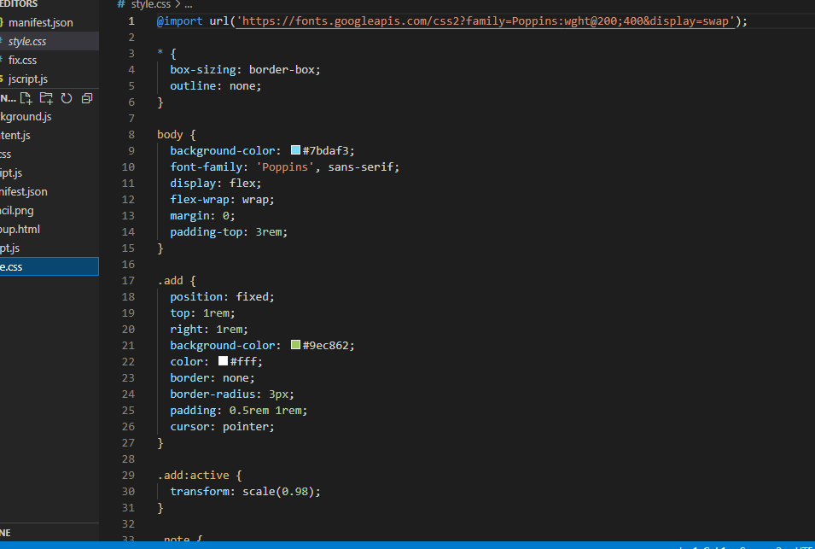
3) style.css :

Slide 20
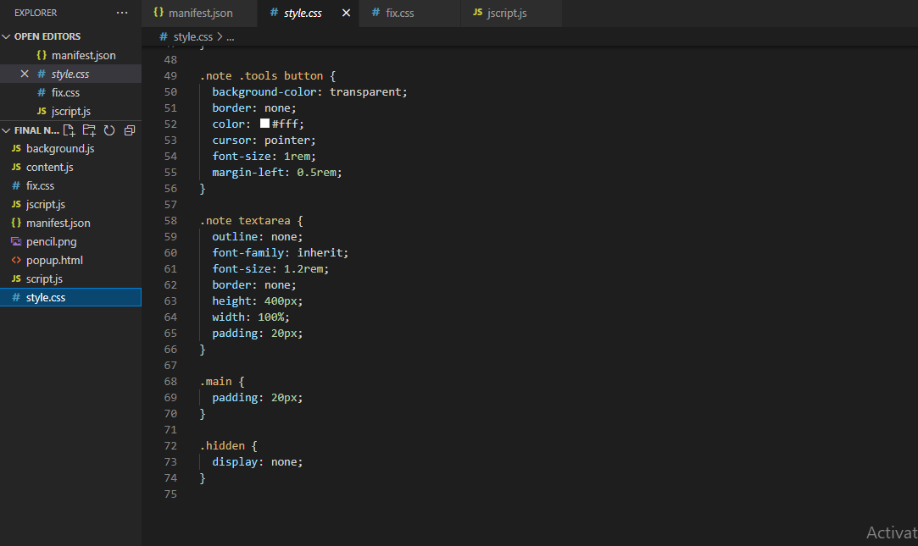

Slide 21
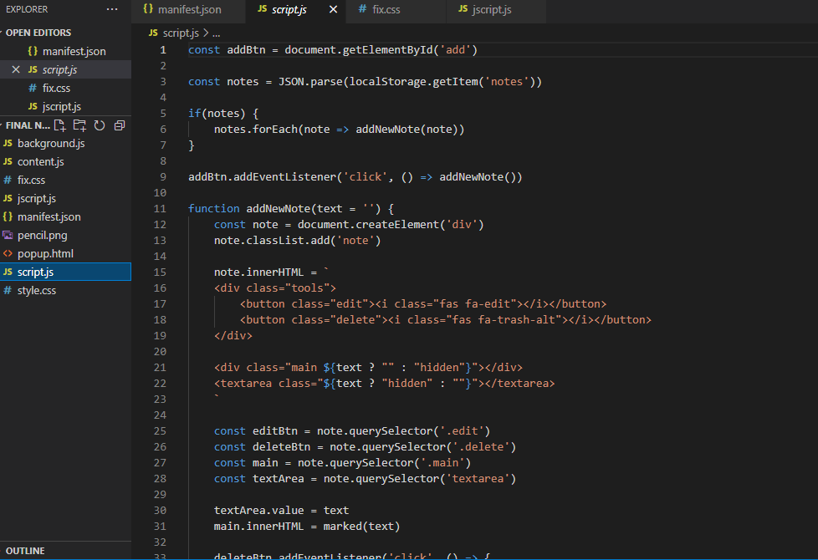
4) script.js

Slide 22
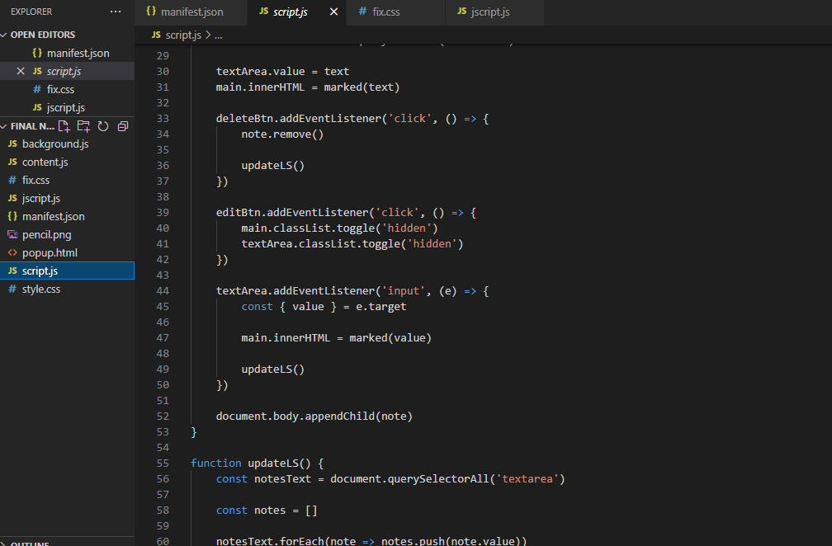

Slide 23
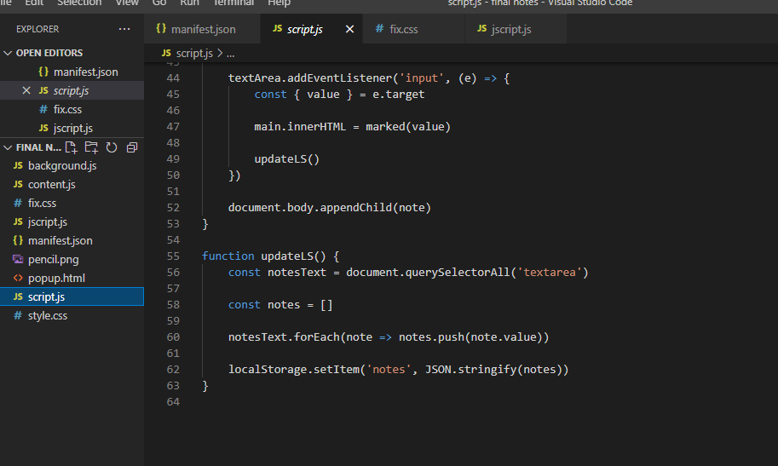

Slide 24
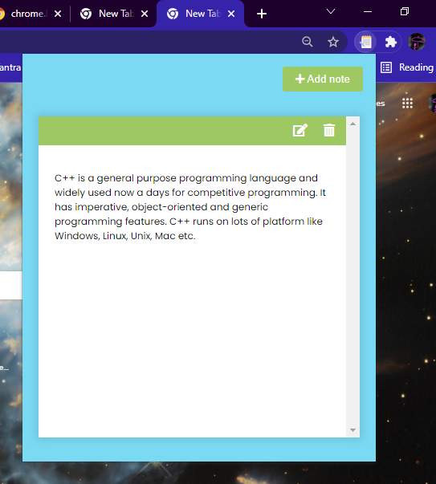
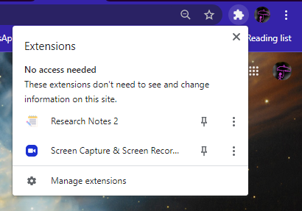
OUTPUT :

Slide 25
REFERENCES :
MY REMARK SKILLS COURSE
Chrome Developers tools(https://developer.chrome.com/)
Geeks For Geeks(https://www.geeksforgeeks.org/)
SOURCE CODE CAN BE ACCESSED THROUGH THE GIVEN LINK:

Slide 26


